Slide 1
Getting Your DB Schema Under Control With SSDT
Peter A. Schott

Slide 2
Intro to SSDT
What is SSDT?
Brief history
Why would you use it?
SSIS
SSAS
SSRS
Databases
Notes:
VS DB Projects – large files, long build/compare times
SSDT – split into SSDT (DB Projects) and SSDT-BI – lots of confusion. BI Projects were version-specific
Current SSDT release – DB Projects, SSIS, SSAS, SSRS – can handle multiple (modern) SQL Versions
This presentation – DB Projects. Why? To get control of your schema in files that can go into source control.

Slide 3
Installing SSDT
Official source
Don’t need VS installed – will install a VS shell
Only install components you need/use
DB Projects installed by default
DB Projects also included in full Visual Studio 2015/2017 installs
Notes:
https://docs.microsoft.com/en-us/sql/ssdt/download-sql-server-data-tools-ssdt

Slide 4
Demo Time!

Slide 5
Common Errors and Issues After Import
3-Part DB Names (current database)
Cross-database views/functions/procs
Linked Server references
Users/Logins not often the same in all environments
Notes:
See next slides

Slide 6
Dealing with 3-Part DB Names – Current DB
SSDT doesn’t know the current database name
Find/Replace is your friend
Limit to *.sql files
Variations
DBName.dbo.
DBName..
[DBName].[dbo].
etc.

Slide 7
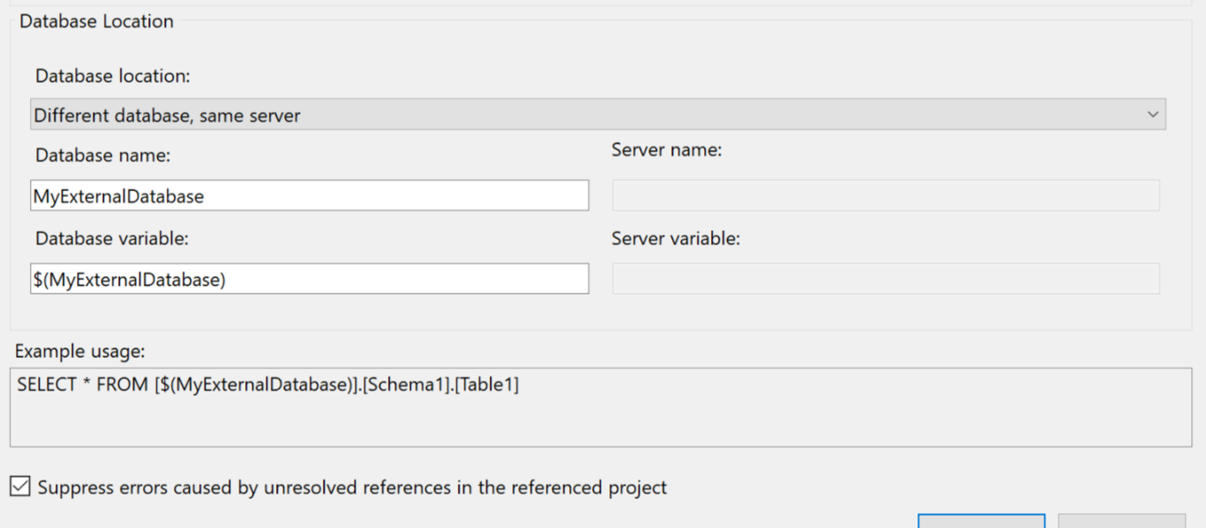
Cross-Database Objects
Database References
Use a common storage location
May need to use SQLPackage to extract a dacpac
Watch your variable settings!
Notes:
Sometimes the import just doesn’t work.
Leave variable blank if DB name will always be the same
Choose “Different Database, Different Server” for linked server dbs
https://msdn.microsoft.com/en-us/library/hh550080(v=VS.103).aspx

Slide 8
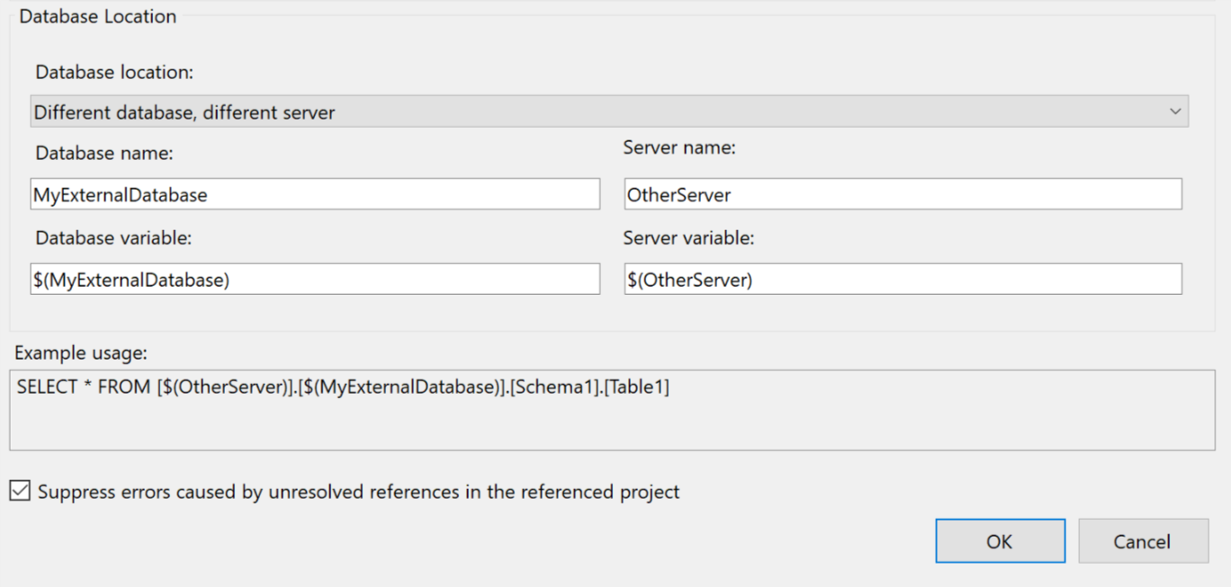
Linked Servers
Similar to Cross-Database objects
Set your options and variables appropriately
Doesn’t seem to work w/ OPENQUERY

Slide 9
Users/Logins
Easiest to ignore initially
Use DB Roles
Import puts these in the “Security” folder
If you really need this, there are ways…
https://schottsql.wordpress.com/2013/05/14/ssdt-setting-different-permissions-per-environment/
Kudos to Jamie Thomson for the idea

Slide 10
Back to the Project!

Slide 11
Potential Gotchas
Large numbers of objects
External databases
Users and Permissions
Rollbacks
SQL Server-only features such as FileStream

Slide 12
Where to Get Help
Stack Overflow:
https://stackoverflow.com/questions/tagged/ssdt
MS Forums:
https://social.msdn.microsoft.com/Forums/sqlserver/en-US/home?forum=ssdt&forum=ssdt
SQL Community Slack:
https://sqlps.io/slack/

Slide 13
Questions?
Peter Schott | @paschott
paschott@outlook.com
http://schottsql.wordpress.com
Files:
https://github.com/paschott/SSDT_101
Rate this presentation:
http://spkr8.com/t/75511

